Slide 1
KRISHI KARMAN AWARDS 2015-16 PRESENTATION BY HIMACHAL PRADESH 14Th March, 2016, 3.00 PM

Slide 2
1. Production and productivity Rice crop. Area in 000’hect. Prod. in 000 M.T, Yield in Kgs / hect.)
S.N. | Year | Area | Production | Yield
1. | 2010-11 | 77.06 | 128.92 | 1672.98
2. | 2011-12 | 74.98 | 127.28 | 1697.69
3. | 2012-13 | 76.90 | 125.28 | 1629.13
4. | 2013-14 | 74.36 | 128.49 | 1727.95
5. | 2014-15 | 72.47 | 127.38 | 1757.73
6. | 2015-16 | 73.69 | 129.88 | 1762.65

Slide 3
2. Production and productivity of Wheat crop. Area in 000’hect. Prod. in 000 M.T, Yield in Kgs / hect.)
S.N. | Year | Area | Production | Yield
1. | 2010-11 | 357.24 | 614.89 | 1721.21
2. | 2011-12 | 355.87 | 629.09 | 1767.76
3. | 2012-13 | 354.27 | 671.94 | 1896.72
4. | 2013-14 | 350.32 | 685.45 | 1956.65
5. | 2014-15 | 330.39 | 648.29 | 1962.19
6. | 2015-16 | 341.05 | 667.62 | 1957.56

Slide 4
3. Production and productivity of Maize crop. Area in 000’hect. Prod. in 000 M.T, Yield in Kgs / hect.)
S.N. | Year | Area | Production | Yield
1. | 2010-11 | 296.37 | 670.90 | 2263.72
2. | 2011-12 | 293.936 | 708.05 | 2408.86
3. | 2012-13 | 294.32 | 657.16 | 2232.81
4. | 2013.14 | 292.78 | 678.25 | 2316.59
5. | 2014-15 | 292.58 | 735.96 | 2515.41
6. | 2015-16 | 294.22 | 737.65 | 2507.12

Slide 5
4. Production and productivity of Barley crop. Area in 000’hect. Prod. in 000 M.T, Yield in Kgs / hect.)
S.N. | Year | Area | Production | Yield
1. | 2010-11 | 22.34 | 32.17 | 1440.26
2. | 2011-12 | 20.63 | 31.46 | 1525.26
3. | 2012-13 | 20.35 | 34.83 | 1711.19
4. | 2013-15 | 20.23 | 35.18 | 1738.79
5. | 2014-15 | 21.73 | 36.70 | 1689.21
6. | 2015-16 | 19.23 | 34.33 | 1785.85

Slide 6
ACHIEVEMENTS OF STATE IN FOOD GRAIN PRODUCTION 2015-16: (Area in 000’hect. Prod. in 000 M.T, Yield in Kgs / hect.)
S.N. | Crop | Area | Production | Yield
1. | Rice | 73.69 | 129.88 | 1762.65
2. | Maize | 294.22 | 737.65 | 2507.12
3. | Wheat | 341.05 | 667.62 | 1957.56
4. | Barley | 19.23 | 34.33 | 1785.85
5. | Pulses | 30.53 | 59.55 | 1950.54
6. | Millets & Bajra | 4.27 | 3.09 | 725.04
7. | Ragi | 1.88 | 1.93 | 1026.57
 | Total Food Grains:- | 764.87 | 1634.07 | 2136.40

Slide 7
ACHIEVEMENTS OF STATE IN FOOD GRAIN PRODUCTION FROM : 2010-11 to 2015-16 (Area in 000’hect. Prod. in 000 M.T, Yield in Kgs / hect.)
S.N. | Year | Area | Production | Yield
1. | 2010-11 | 795.18 | 1493.87 | 1878.65
2. | 2011-12 | 786.58 | 1532.77 | 1948.64
3. | 2012-13 | 786.43 | 1541.33 | 1959.91
4. | 2013-14 | 774.72 | 1585.13 | 2046.05
5. | 2014-15 | 755.21 | 1607.88 | 2129.05
6. | 2015-16 | 764.87 | 1634.07 | 2136.40

Slide 8
NEW INNOVATIONS / INITIATIVES
Introduced new Farm Machinery like:
Reaper cum Binder , Paddy Transplanter , Power Weeder, Power Plough , Power Tiller.
High Seed Replacement Rate.
Introduction of High yielding Hybrids.
Promotion of Water soluble Fertilizers.
Large Scale Farmers Field Schools in Rice, Wheat, Pulses and Maize.

Slide 9
COVERAGE OF NFSM PROGRAMME 2015-16
Total Districts : Twelve
NFSM-Rice : Two Districts
NFSM-Wheat : Eleven Districts
NFSM-Maize : Nine Districts
NFSM-Pulses : All Districts

Slide 10
EXPENDITURE UNDER NFSM 2015-16 ( Rs. in Lac)
S.N. | Programme | Allocation | Expenditure | %
1. | NFSM-RICE | 165.00 | 165.00 | 100
2. | NFSM-MAIZE | 397.00 | 397.00 | 100
3. | NFSM-WHEAT | 1068.91 | 940.38 | 87.97
4. | NFSM-PULSES | 92.34 | 92.32 | 99.97
5. | Addl. Area Coverage | 99.58 | 98.58 | 98.99
 | Total:- | 1822.83 | 1693.28 | 92.89
The State has implemented this scheme on 50:50 basis instead of 90:10
H.P. is not covered under BEGRI and NMOOP of RKVY

Slide 11
COORDINATION WITH RELATED LINE DEPARTMENTS
Meetings of District Irrigation Committees were held regularly in order to ensure regular supply of Irrigation Water.
Himachal is a power surplus state so regular power supply was ensured to Agriculture on subsidised rates.
Adequate Credit disbursement was ensured through KCC.
There was no Shortage of Fertilizer during 2015-16, adequate allocation and Supply ensured.
Adequate Supply of Seed and PP Material was ensured through Public and Private Network.

Slide 12
POST HARVEST MANAGEMENT AND MARKETING SUPPORT
State is self sufficient in Food Grain and there is little Marketable surplus to be procured under MSP.
For efficient Marketing of Food Grains, 57 Marketing Yards have been set up in the State.
State has also repealed the APMC Act in 2005 and full- fills the eligibility for National Agriculture Market.
Provisions have been made in APMC Act for Direct Marketing, e- marketing, single point levy of Market Fee, Contract Farming and Setting up of Private Markets.
Post Harvest Facilities are being set up in the APMC yards under PP Mode.

Slide 13
. New Initiatives Introduction of Reaper cum binder in Wheat/Rice
H.P. :10.2
Cost : Rs.3.20 Lakh
Govt. Assistance : Rs.1.50 Lakh
Efficiency of harvesting
: 1 Acre/ hr.
Tested by : Farm Machinery &
Training Institute, Hissar (HR.)
Oil Consumption: 1 Lt / hr (diesel)

Slide 14
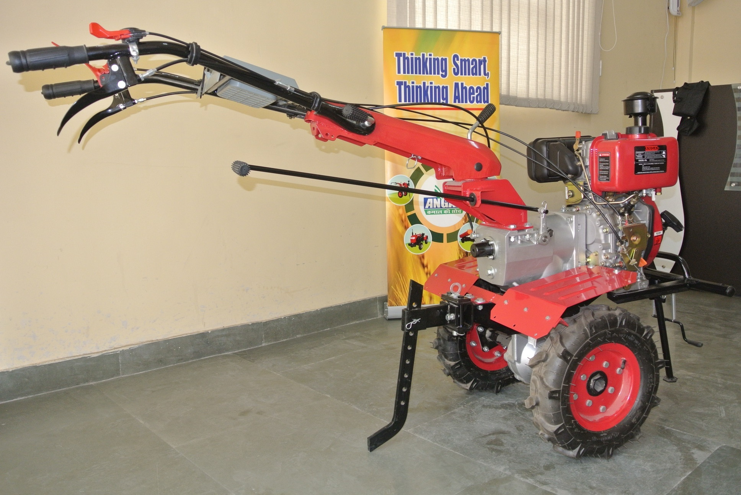
Introduction of Power Weeders
H.P. : 6 and 8
Cost : Rs.80,000 and
Rs.90,000
Attachments:
Paddler , Leveler & Rotter
Govt. Assistance: Rs.15,000
Attachments extra
Plough, Tines, Seed Drill
Efficiency : 1/2 Acre/ hr.
Oil Consumption: 0.5 Lt / hr (diesel)

Slide 15
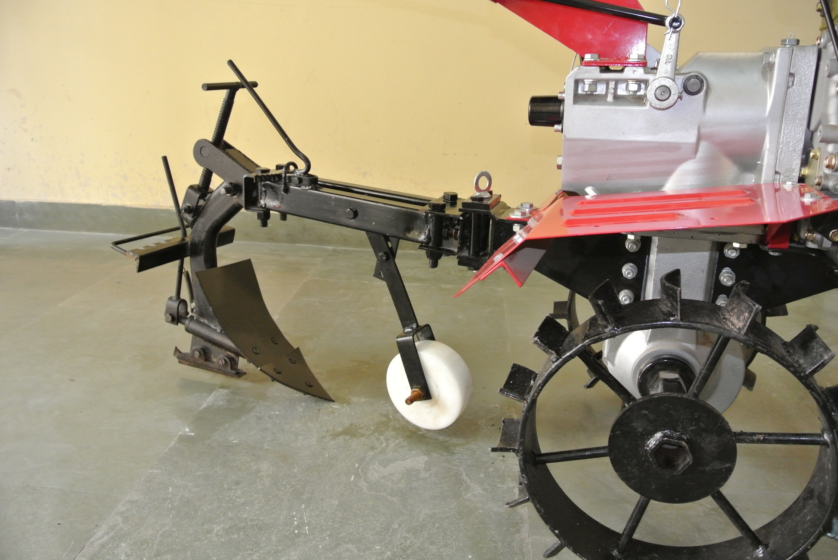

Slide 16
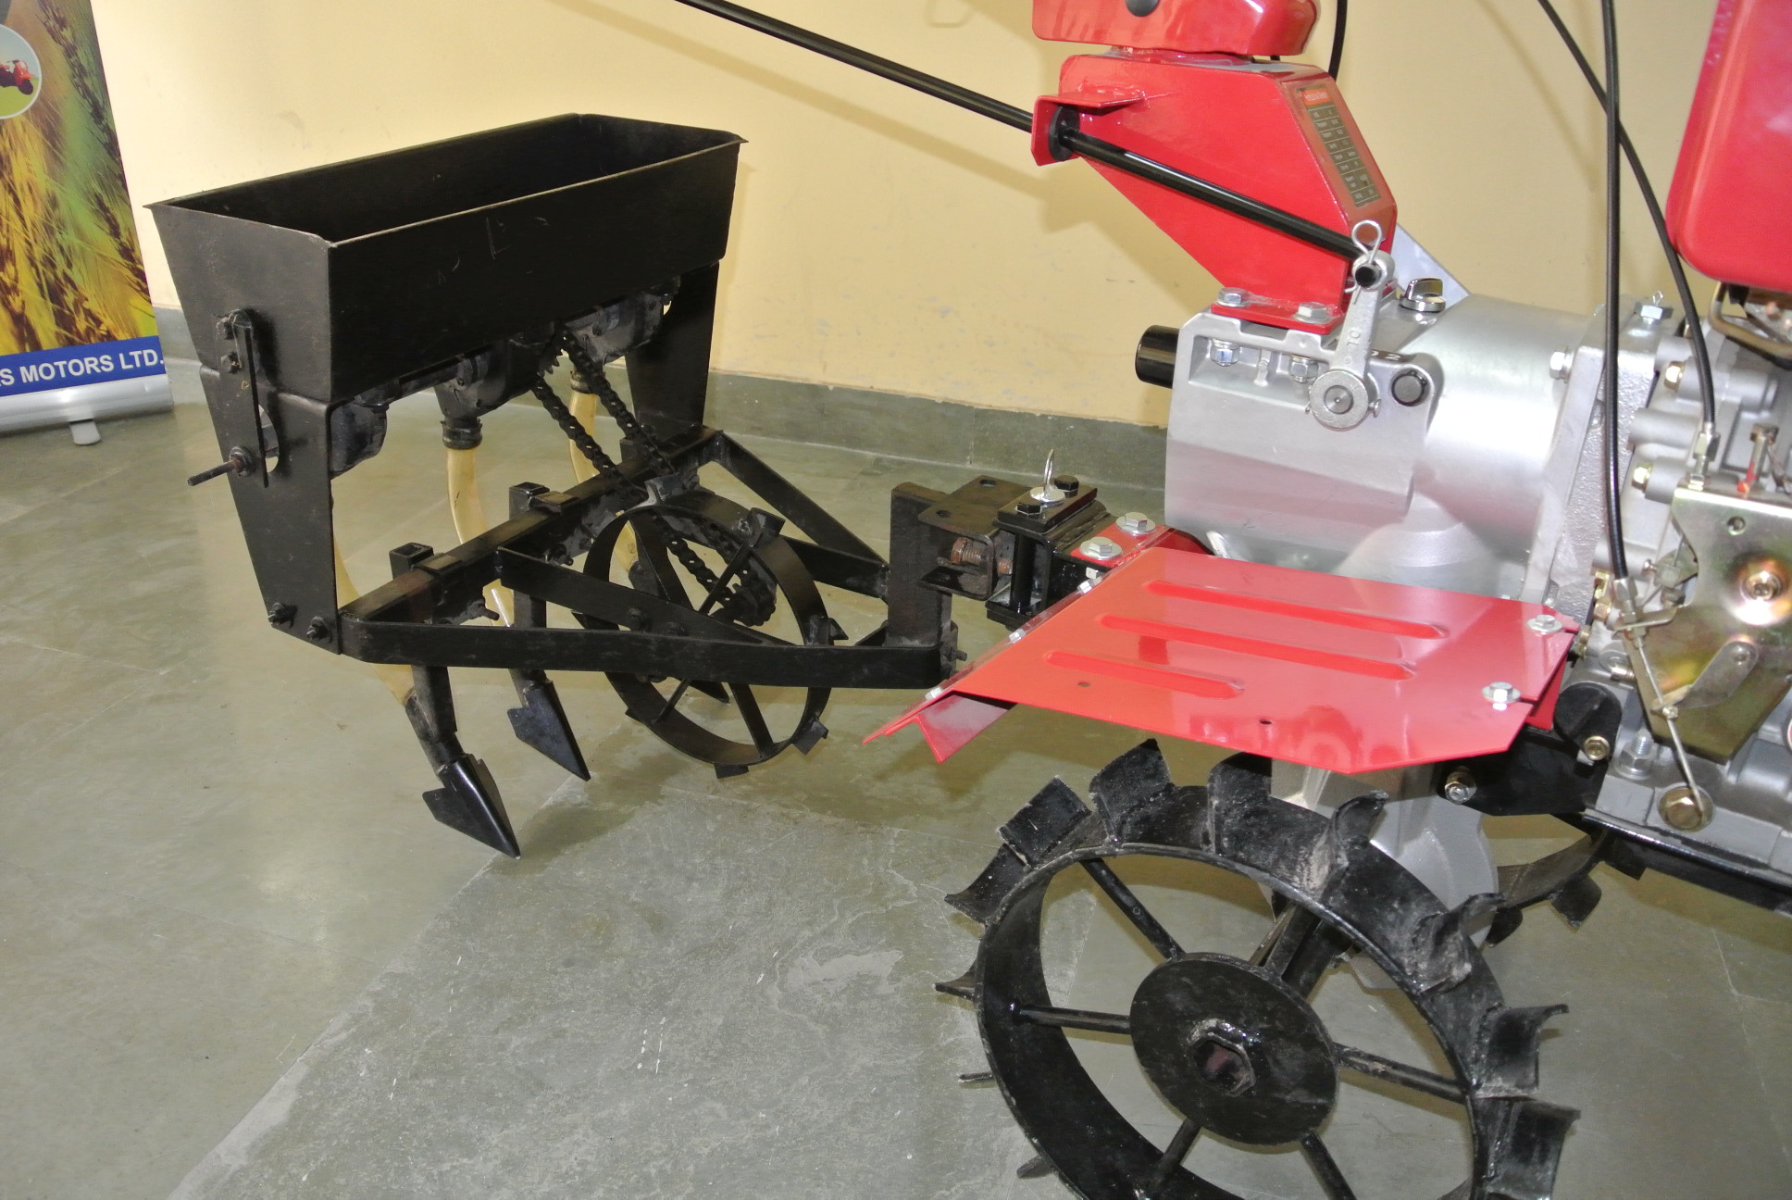

Slide 17
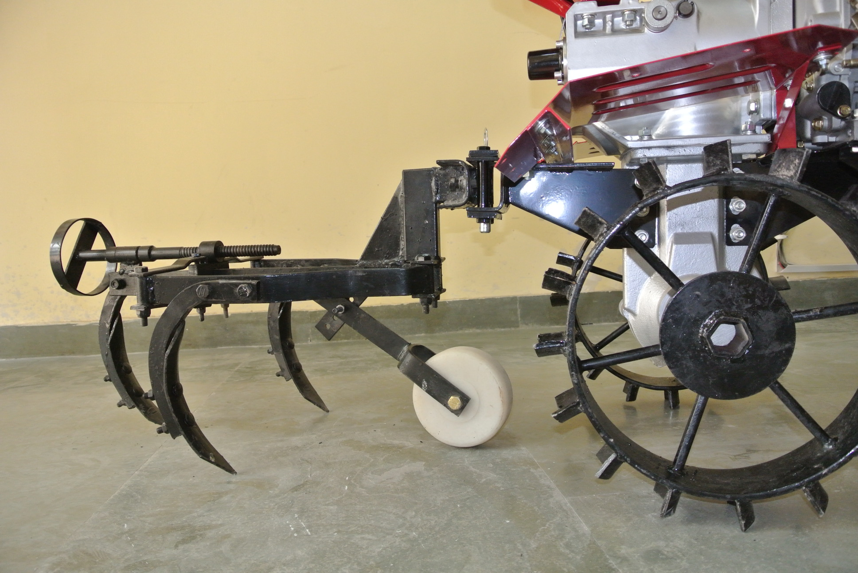

Slide 18
FUTURE STRATEGY AND MEASURES TAKEN TO ACHIEVE HIGHER PRODUCTION
Balanced Fertilization and Distribution of Soil Health Card to every Farmer.
More emphasis on Mechanization due to shortage of Farm Labour.
More Area coverage under High yielding Hybrids in Rice and Maize.
Bringing more area under Pulses through Mix./ Inter Cropping.
Improving Irrigation Efficiency through large area Coverage through Sprinklers.
Crop Protection through Solar fencing .

Slide 19
THANKS

Slide 20
Physical and financial progress under NFSM 2015-16
1. | NFSM-Rice 2015-16 |  |  |  | (Rs. in Lac)
S. | Interventions | TARGETS |  | ACHIEVEMENTS
N. |  | Phy. | Fin. | Phy. | Fin.
1. | (a) Cluster Demonstration | 700 | 52.50 | 700 | 52.50
 | (b) Cropping System based Demonstration | 210 | 26.25 | 210 | 26.25
2. | Seed Distribution: HYVs Seeds | 3324 | 32.50 | 3174 | 32.50
3. | Plant and Soil Protection Management | 4138 | 20.69 | 4138 | 20.69
4. | Resource Conservation Technique / Tools | 946 | 16.00 | 946 | 16.00
5. | Incentive for Pump Sets | 30 | 3.00 | 30 | 3.00
6. | Cropping System based trainings, | 22 | 0.77 | 22 | 0.77
7. | Local Initiatives | 49 | 13.29 | 49 | 13.29
 | Total:- |  | 165.00 |  | 165.00

Slide 21
Physical and financial progress under NFSM 2015-16
1. | NFSM-Wheat 2015-16 |  |  |  | (Rs. in Lac)
S. | Interventions | TARGETS |  | ACHIEVEMENTS
N. |  | Phy. | Fin. | Phy. | Fin.
1. | (a) Cluster Demonstration | 4100 | 307.50 | 4100 | 307.50
 | (b) Cropping System based Demonstration | 1190 | 148.70 | 1190 | 148.70
2. | Seed Distribution: HYVs Seeds | 20000 | 200.00 | 20060 | 200.33
3. | Plant and Soil Protection Management | 16354 | 81.77 | 16534 | 82.67
4. | Resource Conservation Technique / Tools | 3151 | 72.90 | 4796 | 89.21
5. | Efficient Water Application Tools | 12100 | 40.00 | 12746 | 38.69
6. | Cropping System based trainings, | 73 | 6.30 | 31 | 4.27
7. | Miscellaneous Expenses |  | 125.00 |  | 18.70
 | Local Initiatives |  | 86.74 |  | 50.26
 | Total:- |  | 1068.91 |  | 940.38

Slide 22
Physical and financial progress under NFSM 2015-16
3. | NFSM-Maize 2015-16 |  |  |  | (Rs. in Lac)
S. | Interventions | TARGETS |  | ACHIEVEMENTS
N. |  | Phy. | Fin. | Phy. | Fin.
1. | Cluster Demonstration | 3949 | 197.00 | 3174 | 158.70
2. | Seed Distribution: HYVs / Hybrid Seeds | 4000 | 200.00 | 11915 | 238.30
 | Total:- |  | 397.00 |  | 397.00

Slide 23
Physical and financial progress under NFSM 2015-16
4. | NFSM-Pulses 2015-16 |  |  |  | (Rs. in Lac)
S. | Interventions | TARGETS |  | ACHIEVEMENTS
N. |  | Phy. | Fin. | Phy. | Fin.
1. | (a) Cluster Demonstration | 500 | 37.50 | 500 | 37.50
 | (b) Cropping System based Demonstration | 150 | 18.75 | 150 | 18.75
2. | Seed Distribution: HYVs Seeds | 600 | 15.00 | 540 | 13.50
3. | Distribution of P P chemicals | 1000 | 5.00 | 1300 | 6.48
4. | Efficient Water Application Tools | 28800 | 7.20 | 28800 | 7.20
5. | Cropping System based trainings, | 14 | 0.49 | 14 | 0.49
 | Local Initiatives | 40 | 8.40 | 40 | 8.40
 | Total:- |  | 92.34 |  | 92.32

Slide 24
Physical and financial progress under NFSM 2015-16
5. | NFSM Addl. Area Coverage |  |  |  | (Rs. in Lac)
S. | Interventions | TARGETS |  | ACHIEVEMENTS
N. |  | Phy. | Fin. | Phy. | Fin.
1. | Cluster Demonstration | 350 | 26.25 | 340 | 25.50
2. | Seed Distribution: HYVs Seeds | 2000 | 50.00 | 1996 | 49.90
3. | Integrated Nutrient Management | 700 | 3.50 | 1019 | 4.92
4. | Plant and Soil Protection Management | 1344 | 6.72 | 1100 | 5.15
5. | Resource Conservation Technique / Tools | 100 | 3.00 | 100 | 3.00
6. | Local Initiatives | 41 | 10.11 | 41 | 10.00
 | Total:- |  | 99.58 |  | 98.58

