Slide 1
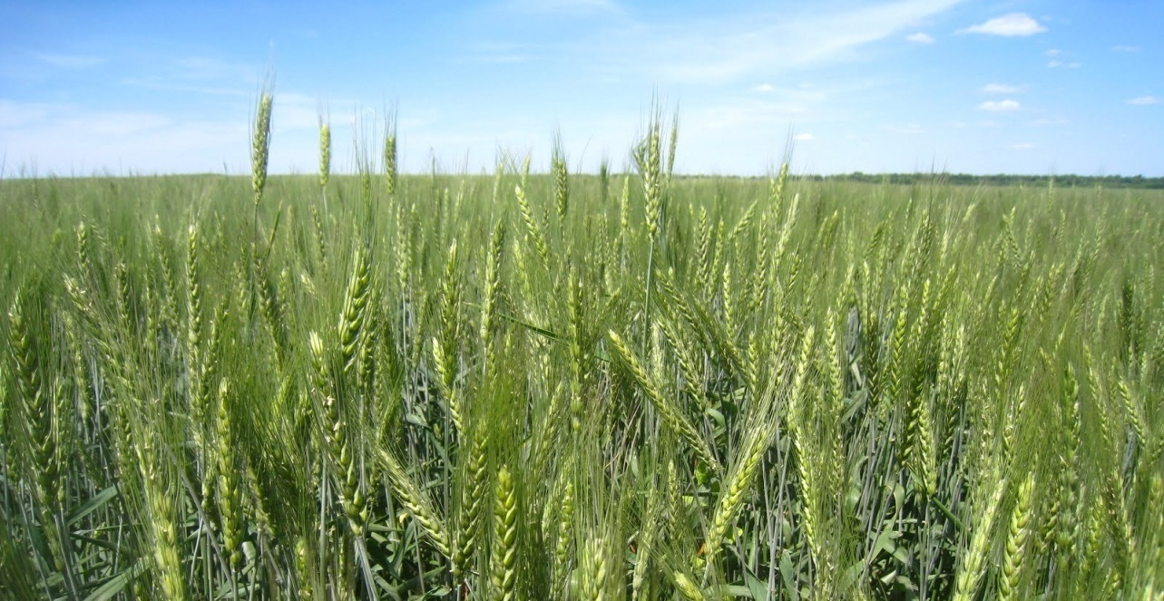
Department of Farmer Welfare and Agriculture Development,
Madhya Pradesh
ON THE PATH OF AGRARIAN PROSPERITY,
PERFORMANCE AND STRATEGIC INTERVENTIONS
14 March 2017

Slide 2
Production - All Food Grains
Unit - Lakh Tones
18.35% *
24.85%
16.16%
-3.01%
36.40%
Source : Agri. Statistics Hand Book (GoI), *CLR, M.P.
Percentage Increase over previous year

Slide 3
Production - Wheat
Unit - Lakh Tones
7.64% *
32.20%
13.55%
-1.27%
51.29%
Source : Agri. Statistics Hand Book (GoI), *CLR, M.P.
Percentage Increase over previous year

Slide 4
Production - Rice
Unit - Lakh Tonnes
46.76% *
27.46%
42.61%
2.49%
25.68%
Source : Agri. Statistics Hand Book (GoI), *CLR, M.P.
Percentage Increase over previous year

Slide 5
Production - PULSES
Unit - Lakh Tones
17.11% *
24.12%
-10.10%
3.96%
22.92%
Source : Agri. Statistics Hand Book (GoI), *CLR, M.P.
Percentage Increase over previous year

Slide 6
Production - Coarse Cereals
Unit - Lakh Tones
45.96% *
22.66%
13.84%
6.08%
-2.52%
Source : Agri. Statistics Hand Book (GoI), *CLR, M.P.
Percentage Increase over previous year

Slide 7
Productivity – All Food Grains
Unit - Kg/Ha
17.62% *
15.78%
10.99%
-4.36%
29.95%
Source : Agri. Statistics Hand Book (GoI), *CLR, M.P.
Percentage Increase over previous year

Slide 8
Productivity – Wheat
Unit - Kg/Ha
9.30% *
18.50
5.00%
-2.95%
34.32%
Source : Agri. Statistics Hand Book (GoI), *CLR, M.P.
Percentage Increase over previous year

Slide 9
Productivity – Rice
Unit - Kg/Ha
56.06% *
14.25%
10.00%
0%
21.16%
Source : Agri. Statistics Hand Book (GoI), *CLR, M.P.
Percentage Increase over previous year

Slide 10
Productivity – PULSES
Unit - Kg/Ha
21.05%
11.87% *
-11.42%
1.74%
22.41%
Source : Agri. Statistics Hand Book (GoI), *CLR, M.P.
Percentage Increase over previous year

Slide 11
Productivity – Coarse Cereals
Unit - Kg/Ha
41.69% *
14.24%
-1.75%
11.22%
13.30%
Source : Agri. Statistics Hand Book (GoI), *CLR, M.P.
Percentage Increase over previous year

Slide 12
Wheat - Production and Procurement
Unit - Lakh Tones

Slide 13
Agriculture loan
Unit - in Cr.

Slide 14
Total Kisan Credit Card
Unit - Lakh No.

Slide 15
ADOPTED STRATEGIES, MEASURES AND INNOVATIONS
A. IRRIGATION AND LAND MANAGEMENT:
Canal assured irrigated area of 9.75 lakh ha in 2008-09 has been increased to 36.02 lakh ha in 2015-16. 3.73 Lakh ha area has been increased in a single year (2015-16).
In the year 2012-13 total irrigated area (all sources) was 89.65 lakh ha, which has been increased to 104.98 lakh ha in 2015-16.
2.62 lakh ha Watershed Area has been treated in the year 2015-16.
To increase irrigation facilities 17,728 Dug wells were constructed in the year 2015-16 under Kapildhara Yojana.
Third crop area has been enhanced to 3.75 lakh ha in 2015-16.
14.33 lakh ha tempory fallow land in 2007-08 has been reduced to 6.10 lakh ha in 2015-16 by extensive campaign at all levels. Area of 1.11 Lakh ha fallow land has been converted into cultivable land in a single year (2015-16).

Slide 16
B. AGRICULTURE EXTENSION AND PROCESS INNOVATION
In the year 2015-16 20.50 crore agricultural advisories sent through Mobile SMS to farmers in Hindi.
Seeds of new varieties i.e., Soybeen ( JS-2069), gram (JGK-5 and RVJ-202), paddy (JRH-19 and JRV-1) Jowar (RVICHS-28 and RVJ-1862) Kodo (JK-37) and Cotton ( RVK-67) have been notified in the state during 2015-16.
Notified seeds of new varieties i.e., Soybeen ( JS-2029, JS-2034, RVS-2001-4), Hy. Arhar (ICPH-2671), Wheat (MP-3366, MP-1255) and lentil (RVL-31) have been distributed to the farmers during past three years.
About 5.48 Lakh ha of land brought under SRI method of paddy cultivation. 40,000 cono-weeders and 20,000 markers have been provided on 90% subsidy.

Slide 17
B. AGRICULTURE EXTENSION AND PROCESS INNOVATION
SRR in all major crops have been increased in Wheat from 14.03% to 27.59%, Paddy from 8.85% to 22.22%, Maize from 10.94% to 73.34% Gram from 2.90% to 12.52%, Soybean from 14.77% to 26.78%, Mustard from 16.88 to 48.59% (as compared to base year 2007-08)
Replacement of Traditional broadcasting system of sowing to Line Sowing in 5.00 lakh ha additional area in Bundelkhand and Baghelkhand region by vigorous extension efforts.

Slide 18
C. TECHNOLOGY EXTENSION AND TRANSFER
To save Kharif crop from untimely heavy rains due to climate change, ridge-furrow method of sowing has been extensively encouraged. About 36 lakh ha has been covered under ridge-furrow method in Kharif 2015.
About 4.00 lakh ha agriculture land deep ploughed under Haldhar Yojana during year 2015-16.
Under the seed quality improvement programme, 52,000 villages provided with Spiral graders and seed treating drums for free of cost usage by farmers.
Raised-bed planting technique has been successfully introduced in Kharif crops by covering about 50,000 ha area.

Slide 19
D. INNOVATIONS -
200 villages have been developed as Yantradoot Gram (Mechanized Villages), where farmers are encouraged to adopt mechanized farming. Phenomenal increase in productivity in all crops has been recorded by independent Third Party Evaluation.
The state government ensures Markfed and PACS for advance lifting and storage of 16.22 lakh MT fertilizers in the year 2015-16 .
Substantial increase in area and production of Hybrid Maize has been achieved by providing 90% subsidy to the SC/ST farmers.
Organic Seed Production programme has been taken up in 10 Govt. Farms. M.P. will become the pioneer in organic seed production in India. During 2015-16 total 697 Qt. of organic seeds have been produced.
MUKHYA MANTRI KHET TIRTH YOJNA started in 2013-14 (Selected Khet Tirth - Outside the state 51, within the state 51 and within the district 823) 96988 farmers benefited from the scheme in 2015-16.

Slide 20
D. INNOVATIONS -
Introduction of short duration of variety of Pigeon Pea UPAS-120 with ridge and furrow method (0.49 lakh ha).
Dharwad method of planting introduced in Pigeon pea (0.73 lakh ha).
Krishi Mahotsav 2015 was organised in the State from 25-05-2015 to 20-06-2015. In this Mahotsav 35,000 Govt. field functionaries of various departments along with agriculture scientists, etc. participated. Krishi Kranti Raths visited all 313 blocks in 20,451 gram panchayats with agriculture experts. 307 Block level sangosthi, 46 district level fairs and 02 state level farmer fairs were organized. 2.75 lakh soil samples were collected.
During this Mega event 1.60 lakh seed kit, 23.16 lakh milch animals vaccinated, 357 new milk producing societies were formed. 2.55 lakh KCC were distributed to the farmers. 95,607 Khasara-Katoni. 1.93 lakh Horticulture / Forestry plants were distributed. 0.62 lakh permanent pump connection sanctioned, but 259 MT grain were collected as donation from farmers which were donated to the different Anganbadis.

Slide 21
E. CREDIT AND MANAGEMENT INTERVENTIONS –
Scheme named Mukhya Mantri Krishak Sahakari Rin Sahayta Yojana was launched in Rabi 2015-16 in which any farmer taking a loan for inputs from Co-operatives, will only have to pay 90% of the loan taken.
The interest rate in Agriculture Loans was 5% in 2009-10 which has been reduced to 0% in 2012-13. Crop Loan by cooperative banks has increased from Rs.5,845 crores in 2010-11 to Rs. 13,809.24 crores in the year 2015-16.
25.18 lakh KCC in a single year (2015-16) have been distributed. Presently 76.70 lakh farmers have KCC.
2523 Seed Growers Co-operatives formed for augmenting availability of certified seeds. State produced 30.12 lakh quintals certified seeds in the year 2015-16.

Slide 22
F. POWER SUPPY TO FARMERS–
State Govt. provides subsidy on Agriculture consumers since 2009-10. In the year 2015-16, power subsidy of Rs. 6717.53 crore was provided by the state government on agriculture pumps.
5.10 lakh temporary and 3.90 permanent irrigation pump connections were provided to meet the demand during 2015-16.
Rural feeder separation has been completed in 2015-16 for providing quality and continuous supply of electricity for 10 hours for agricultural operations. Second largest Feeder separation in India.
The power to agriculture sector increased to 18.8 billion units in 2015-16 (Compared to 6.7 billion units in 2009-10).

Slide 23
G. POLICY INTERVENTIONS:
1. Krishi Cabinet constituted for ensuring better coordination among the Departments of Agriculture, Horticulture, Animal Husbandry, Dairy, Power, Irrigation and Cooperative.
2. Warehousing and Infrastructure : The state has taken warehousing in a big way wherein the warehousing storage capacity of 79 Lakh MT in 2010-11 has been increased to 158 Lakh MT. The highest for any state in India.

Slide 24
Expenditure Incurred under Food Grain Development Schemes 2015-16
Rs in Lakh
Scheme | Fund Available | Expenditure | % Expenditure
NFSM
Paddy | 1475.01 | 486.33 | 32.97
Wheat | 3100.06 | 1652.57 | 53.31
Pulses | 23802.58 | 16419.16 | 68.98
Coarse cereals | 1172.71 | 365.24 | 31.14
Cotton | 101.12 | 0.00 | 0.00
Sugarcane | 19.56 | 13.25 | 67.74
Total NFSM | 29671.04 | 18936.55 | 63.82
NMOOP | 6963.09 | 3257.6 | 46.78
Grand Total | 36634.13 | 22194.15 | 60.58

Slide 25
POST HARVEST MANAGEMENT & MARKETING SUPPORT
Private entrepreneurs are being encouraged under bank assisted Custom Hiring Center scheme by providing subsidy up to Rs.10 lakh for each center. 433 new custom hiring centers have been established in the year 2015-16. So far 1208 centers are working in the state.
To discourage burning of crop residues, Govt. is promoting use of reaper cum binder, straw reaper, by giving top-up subsidy @ Rs. 50,000 per machine.
Happy seeder and zero tillage technology is being promoted in Rice-Wheat belt to avoid residue burning and accomplishing timely sowing.
To promote sugarcane cultivation, 13 sugarcane harvesters distributed in the year 2015-16.

Slide 26
POST HARVEST MANAGEMENT & MARKETING SUPPORT
26 Hi-tech custom hiring Hubs equipped with straw reaper, balers etc. will be established in areas prone to residue burning .
In collaboration with NIC, Mandi Board has developed an online software named "e-Anugya''.
A state level Farmer Producer Organization Madhya Bharat Consortium of Farmer Producer Company Limited has been setup. Under this FPO, 72 Crop Producer Companies and 52 societies are registered.
To facilitate movement of agriculture input, farm machinery and transportation of farm produce SUDOOR KHET SADAK YOJNA has been implemented under MGNREGS.

Slide 27
COORDINATION WITH ALLIED DEPARTMENTS
The Krishi Cabinet reviews the performance of each department in detail on regular basis.
Agriculture Production Commissioner reviews the status of inputs and allied problems on every Friday.
Director of Agriculture conducts Video conferencing every week with all Joint Directors and Dy. Directors.
All collectors review progress of agriculture and allied departments in their districts on a weekly basis.

Slide 28
FUTURE ROAD MAP FOR HIGHER FOOD GRAIN PRODUCTION
The state has planned to increase assured canal irrigation from 36 lakh ha. to 60.00 lakh ha by 2022.
It is envisaged to create 22 lakh ha extra irrigated area under Micro Irrigation till 2022. Cent percent fields will be connected with Micro Irrigation under large and medium irrigation projects. State already constituted micro irrigation mission.
2.50 Lakh Dug wells and 5 lakh farm ponds will be constructed.
6 lakh temporary electric connections will be shifted into permanent electric connections.
It is planned to create state wide network of 4500 custom hiring centers in next five years and 25000 solar agriculture pumps will be established . 51 Mega Custom hiring centers (5000 acres/center) by 2017-18.
Assured productivity enhancement of Kharif and Rabi Crops by 20% to 40 % will be achieve with the use of new technologies viz., SRI, Ridge & Furrow system, Raised bed planting, Dharwar System etc.

Slide 29
FUTURE ROAD MAP FOR HIGHER FOOD GRAIN PRODUCTION
Major shift towards SRI 40% of Paddy area (7 lakh ha) proposed to be brought under SRI during next 2 years.
Promotion of SWI in Wheat Crop & System of Root Intensification in Mustard (2.5 lakh ha & 1.5 lakh ha)
20 Lakh ha. area will be taken under zero tillage. Zero tillage also reduces the cost of cultivation about 15%.
Upto march 2017 soil health cards will be distributed among all farmers of the state. State Govt. has sanctioned Rs. 100 crores for constructing 265 new Soil Testing Labs from its own sources. This will ensure one STL per block in the state.
Certification capacity of 2 Lakh ha. area under organic farming per year will be developed.
Area under Jaid crops will be increased from 3.75 lakh ha to 8 Lakh ha.

Slide 30
FUTURE ROAD MAP FOR HIGHER FOOD GRAIN PRODUCTION
Ensuring coverage of whole kharif area (other than rice) under ridge-furrow method of sowing by 2016-17.
Conversion of fallow land- 3 lakh ha Rabi fallow area to be converted in to pulse cultivation.
A campaign on use of recommended seed rate has to be started which may result 10% reduced input cost.
Area under Inter-cropping will be increased from 3 lakh ha to 9 Lakh ha.
To promote Agro-forestry agro-climatic zone wise models have been prepared and Agro-forestry mission constituted .10 Lakh ha area will be extended under Agro-forestry.
New and beneficial crops like Guar, Safflower and castor will be promoted in 3 Lakh ha area.
With the help of mechanization and electrification farm power will be improved from 1.85 kw/ha to 3.5 kw/ha.

Slide 31
FUTURE ROAD MAP FOR HIGHER FOOD GRAIN PRODUCTION
Storage capacity of 10 lakh MT will be achieved in agriculture mandies.
State will have 1200 automated weather stations and 33000 automated Rain Gauges in place by 2017-18. This will ensure agro-meteorological infrastructure through out the state.
An ambitious project on Reclamation of Ravine and Promotion of Farm Mechanization is under process of sanction.
Increasing Crop Loans through Cooperative Banks from Rs.13809 crores to Rs. 20,000 crores in 2017-18.
About 76.70 lakh KCC has already been distributed to the farmers. The target is to cover all 107 lakh farmers with KCC by 2018.
About 1000 farmers will be sent to foreign countries under Mukhyamantri Kisan Videsh Addyayan Yatra Yojana.

Slide 32
FUTURE ROAD MAP FOR HIGHER FOOD GRAIN PRODUCTION
e-Kisan sarthi mobile application and call centers has been started on Pilot basis to provide farm implements/Machineries on one click. This scheme will be launched for whole state from 1 April 2017.
All mandies ofthe state will be covered under National Agriculture Market (NAM) Scheme of GoI.
Every mandi in the state will have vegetable and fruit mandies as well. This will include platforms, model rates information of other mandies of the country, color sortex plants, cleaner, grader, cold chambers etc.
Roadmap for doubling farmers income has been prepared in the state. All 51 districts have also prepared the roadmap which is being intensively monitored at the State and District level.
Area under horticulture crop will be increased from 15 Lakh ha to 22.50 Lakh ha. Horticulture areas will be developed own cluster approach value addition micro industries at Gram Panchayat level and food processing industries will be developed throughout the state.

Slide 33
FUTURE ROAD MAP FOR HIGHER FOOD GRAIN PRODUCTION
Milk production will be increased from 12.14 Million tonnes to 18.68 Million tonnes between the year 2016-17 to 2021-22.
Fisheries development, Sericulture, Lakh production, honey production etc will be taken holistically and extensively with farm activities .

Slide 34
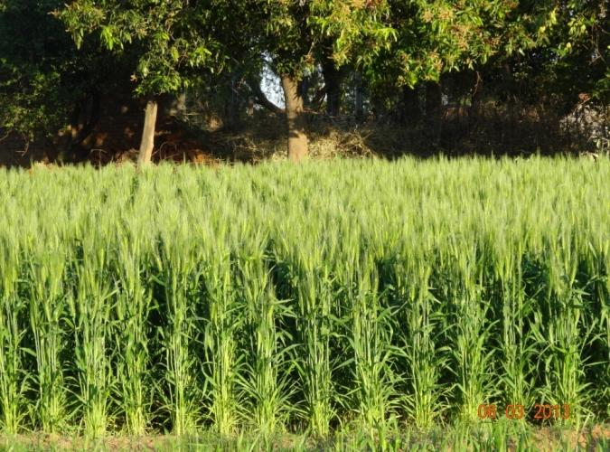
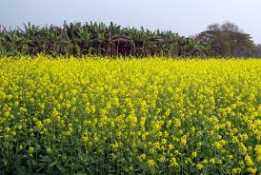
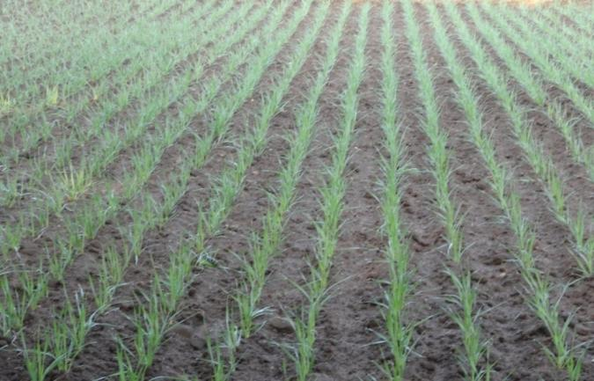
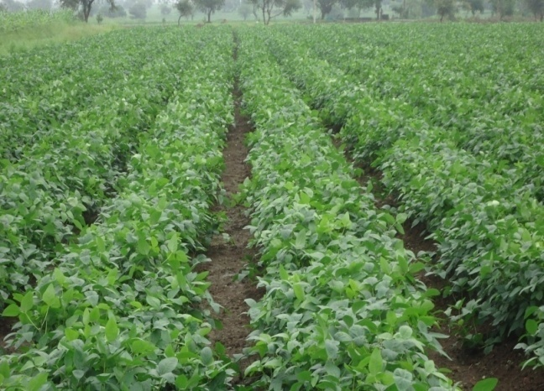
THANK YOU!

