Slide 1
“KRISHI KARMAN AWARD”
FOR RECOGNIZING EFFORTS
OF THE BEST PERFORMING STATES
IN
FOODGRAINS, RICE, WHEAT COARSE CEREALS, PULSES AND OILSEEDS PRODUCTION
DURING 2015-16

Slide 2
GOVERNMENT OF RAJASTHAN

Slide 3
SOME FACTS ABOUT RAJASTHAN
Item | Unit
Geographical Area | Lac. Sq. Km | 3.42
Average size of operational holdings | Ha. | 3.07
Total No. of holdings | Lac Nos. | 68.88
Total cultivable area | Lac Ha. | 255.55
Net Irrigated Area | Lac Ha. | 76.49
Gross Irrigated Area | Lac Ha. | 98.65
Total No. of Cultivators | Lac No. | 136.19
Agriculture Share in GSDP (on current prices) | (%) | 20.27
Per capita income on current prices | Rs. | 65974
Normal Av. rainfall | MM | 463.6

Slide 4
Average rainfall (mm) in Rajasthan during 2015-16
Month | Eastern Rajasthan | Western Rajasthan
June | 96.3 | 53.2
July | 297.3 | 234.6
August | 138.1 | 58.8
September | 20.0 | 35.7
October | 4.5 | 1.1
November | 0.5 | 0.1
December | 0.8 | 0
January | 0 | 0
February | 0.4 | 0.6
March | 3.9 | 6.7
April | 0 | 0.4
May | 9.6 | 4.1

Slide 5
POSITION OF RAJASTHAN IN INDIA
Crop | Area (million ha.) during 2014-15
 | India | Rajasthan | % to India | Position
Bajra | 7.12 | 4.10 | 57.57 | 1st
Mustard | 5.79 | 2.47 | 42.72 | 1st
Coarse Cereals | 24.15 | 6.02 | 24.92 | 1st
Guar | 5.96 | 4.63 | 77.68 | 1st
Oilseed | 25.73 | 4.46 | 17.34 | 2nd
Pulses | 23.10 | 3.36 | 14.55 | 2nd
Food grain | 122.07 | 12.87 | 10.54 | 3rd
Gram | 8.19 | 1.26 | 15.33 | 3rd
Soybean | 11.09 | 0.92 | 8.33 | 3rd
Wheat | 30.97 | 3.32 | 10.71 | 4th
Maize | 9.26 | 0.90 | 9.77 | 5th

Slide 6
POSITION OF RAJASTHAN IN INDIA
Crop | Production (million tones) during 2014-15
 | India | Rajasthan | % to India | Position
Bajra | 9.05 | 4.49 | 49.64 | 1st
Mustard | 6.31 | 2.90 | 45.89 | 1st
Coarse Cereals | 41.75 | 7.57 | 18.12 | 1st
Guar | 3.58 | 2.75 | 76.81 | 1st
Groundnut | 6.56 | 1.02 | 15.56 | 2nd
Oilseed | 26.67 | 5.32 | 19.94 | 2nd
Gram | 7.17 | 0.91 | 12.69 | 2nd
Pulses | 17.19 | 1.95 | 11.34 | 2nd
Soybean | 10.53 | 0.96 | 9.08 | 3rd
Food grain | 252.68 | 19.75 | 7.82 | 4th
Wheat | 88.94 | 9.87 | 11.10 | 5th

Slide 7
PRODUCTION OF CEREALS DURING LAST THREE YEARS
PRODUCTION IN LACS TONNES
Crop | 2013-14 | 2014-15 | 2015-16 | % increase over 2014-15
Rice | 3.13 | 3.67 | 3.7 | 0.8
Jowar | 3.57 | 5.05 | 3.44 | -31.9
Bajra | 41.35 | 44.56 | 32.12 | -27.9
Maize | 14.78 | 15.66 | 11.42 | -27.1
S.Millets | 0.02 | 0.03 | 0.03 | 0.0
Wheat | 110.2 | 98.24 | 104.68 | 6.6
Barley | 9.42 | 9.62 | 7.66 | -20.4
TOTAL CEREALS | 182.46 | 176.67 | 163.05 | -7.7
Note- (1) Production of Kharif crops reduced due to poor and erratic rainfall
(2) Reduction in area under Barley led to lower production

Slide 8
PRODUCTION OF PULSES AND FOODGRAINS DURING LAST THREE YEARS
PRODUCTION IN LACS TONNES
Crop | 2013-14 | 2014-15 | 2015-16 | % increase over 2014-15
PULSES
K.Pulses | 7.64 | 9.53 | 10.4 | 9.1
Arhar | 0.09 | 0.1 | 0.07 | -30.0
Gram | 16.41 | 9.11 | 8.4 | -7.8
R.Pulses | 0.57 | 0.76 | 1.03 | 35.5
TOTAL PULSES | 24.71 | 19.5 | 19.9 | 2.1
FOODGRAINS
KHARIF | 70.57 | 78.67 | 61.17 | -22.2
RABI | 136.6 | 117.73 | 121.78 | 3.4
TOTAL FOODGRAINS | 207.17 | 196.41 | 182.95 | -6.9
Note- (1) Production of Kharif crops reduced due to poor and erratic rainfall
(2) Reduction in area under rainfed Gram due to poor rainfall in Rabi led to lower production

Slide 9
PRODUCTION OF OILSEEDS DURING LAST THREE YEARS
PRODUCTION IN LACS TONNES
Crop | 2013-14 | 2014-15 | 2015-16 | % increase over 2014-15
Sesamum | 0.72 | 1.12 | 1.15 | 2.7
Groundnut | 9.07 | 10.18 | 10.49 | 3.0
Soybean | 9.75 | 9.57 | 8.04 | -16.0
Castor Seed | 2.86 | 3.35 | 2.7 | -19.4
Rapeseed & Mustard | 36.21 | 28.79 | 32.58 | 13.2
Taramira | 1.76 | 0.17 | 0.07 | -58.8
Linseed | 0.03 | 0.03 | 0.02 | -33.3
TOTAL OILSEEDS | 60.41 | 53.21 | 55.05 | 3.5
Note- Production of soybean and some other minor oilseed crops reduced due to poor and erratic rainfall

Slide 10
ACHIEVEMENTS IN PRODUCTION during 2015-16
Production of Rice, Wheat, Total Pulses, Groundnut, Rapeseed & Mustard and Sesamum during 2015-16 was more as compared to previous year.
Percentage increase in production during 2015-16 over 2014-15 was as follows:
Rice- 0.8%
Wheat- 6.6%
Total Pulses- 2.1%
Groundnut- 3.0%
Rapeseed & Mustard- 13.2%
Sesamum- 2.7%

Slide 11
ACHIEVEMENTS IN PRODUCTIVITY DURING 2015-16
PRODUCTIVITY IN KG/HA
Crop | Avg. 2010-11 to 14-15 (5Yrs) | 2015-16 | % increase over last 5 yrs
Rice | 2017 | 2022 | 0.25
Wheat | 3355 | 3367 | 0.36
Barley | 2928 | 2993 | 2.22
Gram | 839 | 892 | 6.32

Slide 12
ACHIEVEMENTS IN PRODUCTIVITY DURING 2015-16
Productivity of Rice, Wheat, Barley and Gram during 2015-16 increased over the average of last 5 years.
Percent increase in productivity during 2015-16 over the average of last 5 years was as follows:
Rice- 0.25%
Wheat- 0.36%
Barley- 2.22%
Gram- 6.32%

Slide 13
EXPENDITURE INCURRED (Rs. In Lacs)
Name of the Scheme | 2013-14 |  |  | 2014-15 |  |  | 2015-16
 | Allot ment | Expendi ture | % | Allot ment | Expendi ture | % | Allot ment | Expendi ture | %
RKVY | 38095 | 35695 | 94 | 76731 | 71733 | 94 | 60201 | 53721 | 89
NFSM | 15464 | 14632 | 95 | 22464 | 14352 | 64 | 24907 | 14831 | 60
NMOOP/ ISOPOM | 5725 | 4664 | 81 | 5945 | 2987 | 50 | 8148 | 5241 | 64
NMAET | - | - | - | 4907 | 2349 | 48 | 7425 | 5403 | 73
PKVY | - | - | - | - | - | - | 3556 | 1864 | 52
State Plan | 46442 | 44767 | 96 | 80620 | 73870 | 92 | 59379 | 44039 | 74
Total | 119942 | 112469 | 94 | 193699 | 165410 | 85 | 168683 | 127161 | 75
Note: Poor and erratic rainfall, introduction of new schemes like PKVY and less availability of seeds in NMOOP, NFSM led to lower progress during 2015-16.

Slide 14
Allotment & expenditure from 2013-14 to 2015-16
Total Budget Allotment in 2013-14 was about Rs. 1200 crore, and in 2015-16 was Rs. 1687 crore.
Budget allotment for Agriculture increased about 40% during last 2 years .
Total Expenditure in 2013-14 was about Rs. 1125 crore and in 2015-16 was Rs. 1272 crore.
Expenditure during 2015-16 was about 75%.
Expenditure under RKVY-89%, NFSM-60%, NMOOP-64%, NMAET-73%, PKVY- 52% and State Plan-74%.

Slide 15
STRATEGY AND MEASURES ADOPTED FOR ENHANCING PRODUCTION
Hybrid Maize Seed distribution in Tribal areas - 8300 Qtls to about 1.66 lacs farmers free of cost.
Total 13.25 Lac Qtls quality seed distributed with 32% SRR in state.
IPM & Seed treatment as campaign for which SEED DRESSING DRUM provided at each Gram Panchayat.
Advance Stocking of 3.47 Lac MT Urea & DAP fertilizers.

Slide 16
STRATEGY AND MEASURES ADOPTED FOR ENHANCING PRODUCTION
TOT ; Trainings & visit -4.23 lacs farmers,
Publication of farmers friendly literature -35 lacs.
Crop Insurance Scheme in all districts, Rs.1744.31 crore claims distributed during 2015-16.
Integrated Nutrient Management Programme during 2015-16.
101 soil testing labs.
Soil Health Cards distributed : 10.15 lacs
Gypsum Distribution- 1.16 Lac MT

Slide 17
INTERVENTION FOR EFFICIENT USE OF WATER
Construction of 1653 diggies with expenditure of Rs.3321.81 lac as subsidy.
In tubewell irrigated areas, 292 Water storage tanks were constructed with an expenditure of Rs. 81.25 lac.
Rain water harvest - 4785 Farm Ponds with expenditure of Rs.2328.59 lacs. In addition to this farm ponds also constructed under MGNREGA.
Irrigation water conveyance 9009 KM pipeline with expenditure of Rs. 2233.64 Lac as subsidy.
Drip & sprinkler sets in 17121 ha. and 26187 ha, respectively.
Solar Pumpsets-3344 with Rs.135 crore and led to 10000 KW additional power generation

Slide 18
NEW INNOVATIONS AND INITIATIVES
State Service Delivery Gateway (SSDG) portal for online applications
ROCL: total 608 Ha olive plantation, 3500 lit oil produced during 2015-16
RACP: For integrated and holistic development in selected clusters of 17 districts.
Nine Center of Excellence established for Citrus, Pomegranate, Date palm, Guava, Mandarin, Mango, Flowers, Vegetables and Custard Apple
GRAMSAT trainings for farmers
Soil fertility Maps using Remote Sensing technology and Soil health cards prepared
PROP- Pest management guide with visuals
Organic farming promotion: 755 organic clusters including 36900 farmers created under PKVY.
Farm Mechanization- 14 Custom hiring Centers have been established

Slide 19
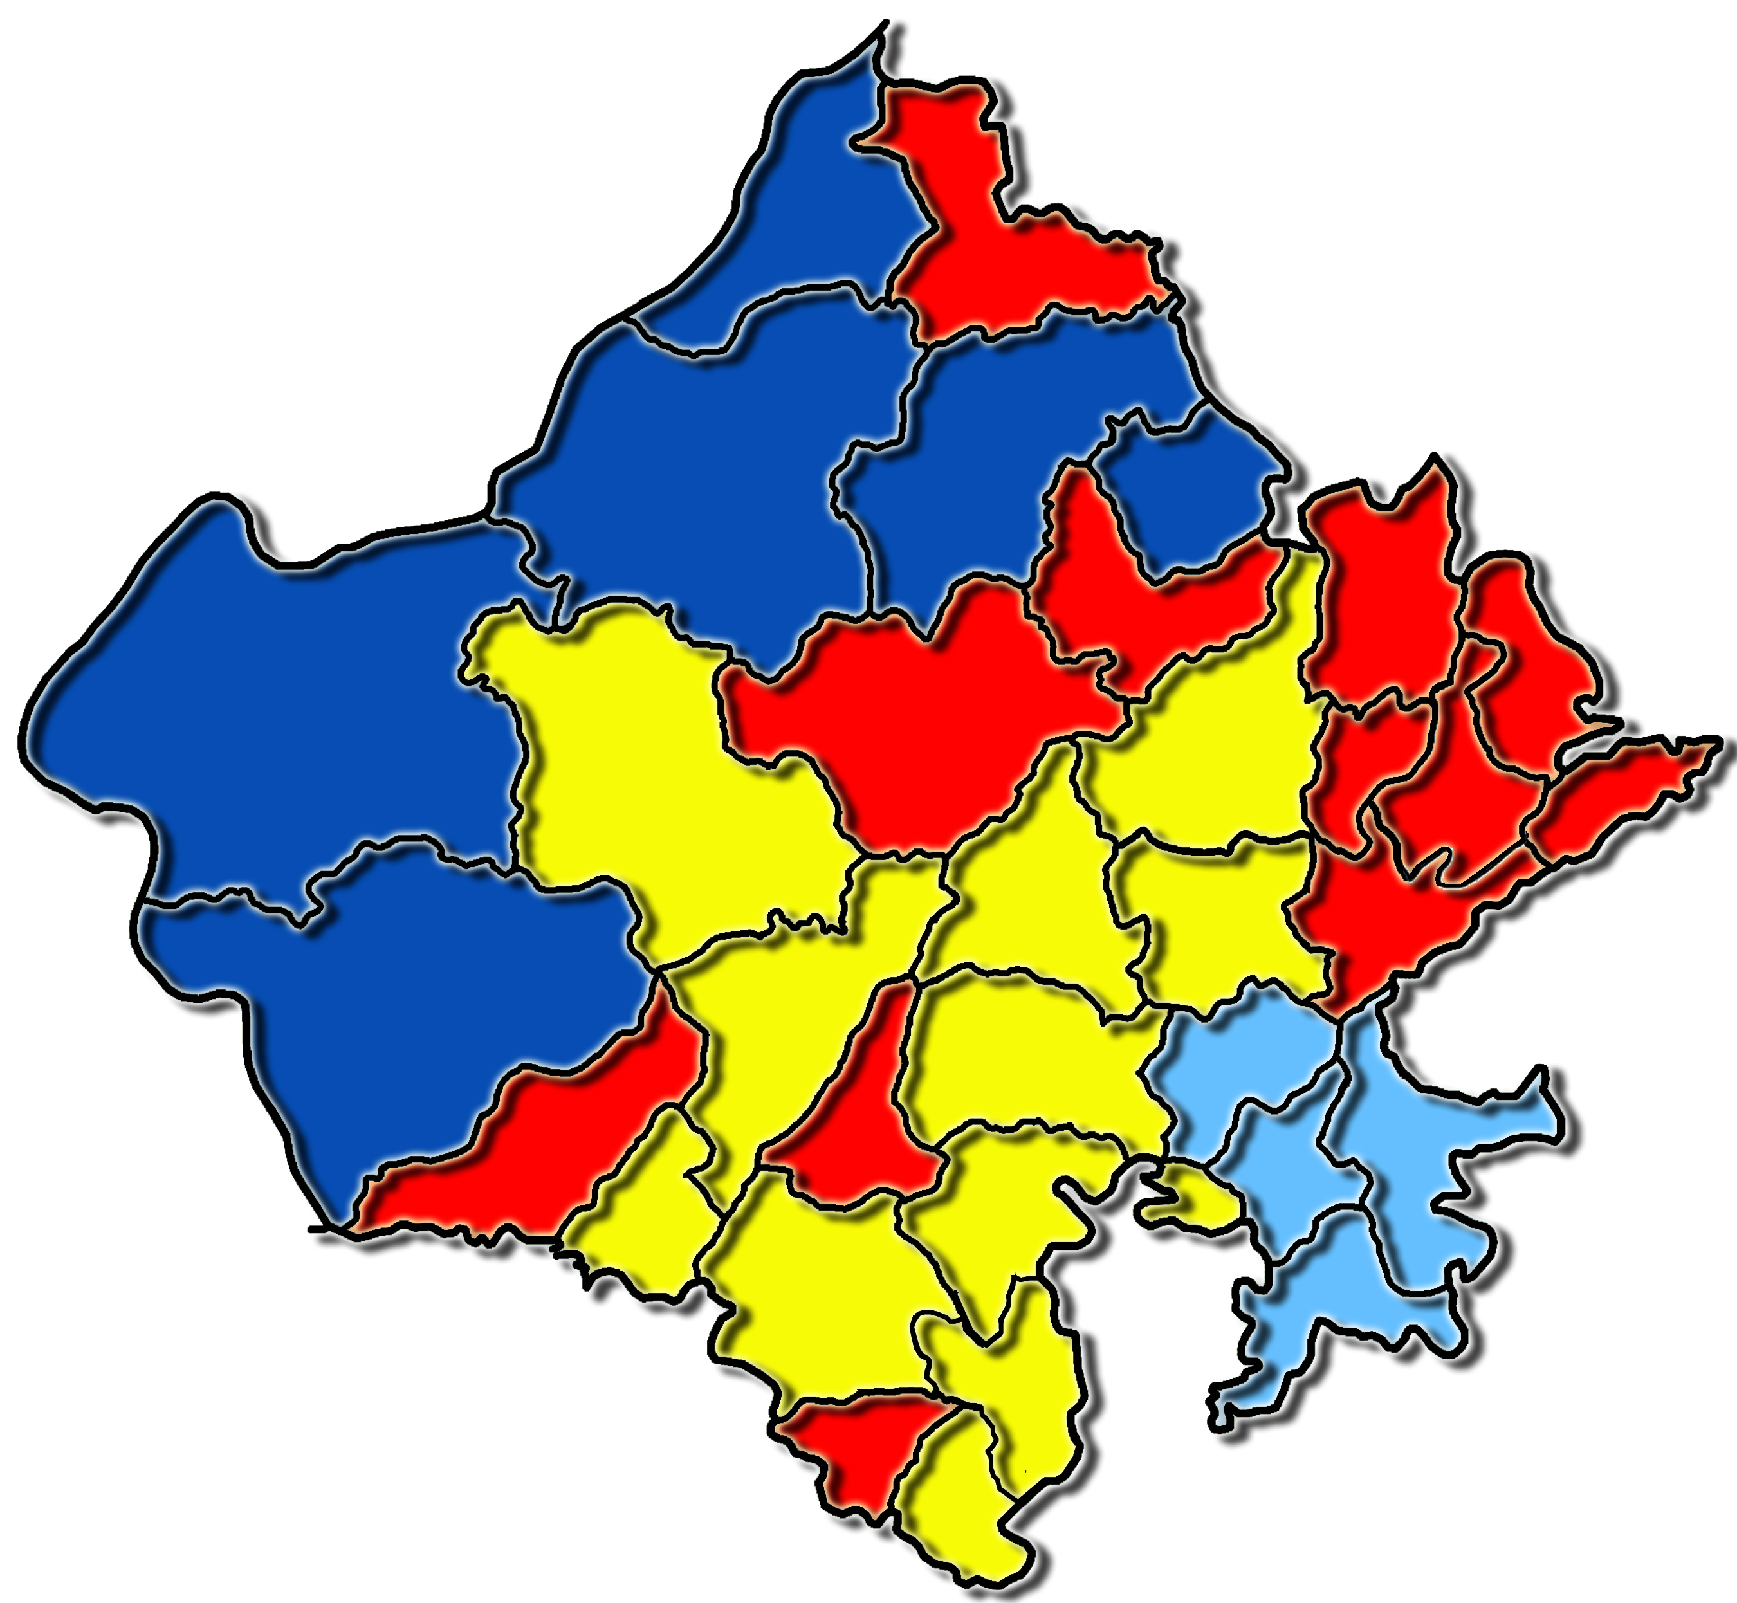
xaxkuxj
vfHkuo dk;ZØe ¼vkjdsohokbZ½ -----
guqekux<
jkT; dh e`nkvksa dk moZjrk Lrj
chdkusj
pw:
>qa>auw
lhdj
vyoj
tSlyesj
ukxkSj
Hkjriqj
t;iqj
nkSlk
v-fu-&vfr fuEu]
fu&fuEu]
e&e/;e]
m&mPp]
tks/kiqj
djkSyh
/kkSyiqj
vtesj
Vksad
lokbZek/kksiqj
ckMesj
ikyh
jkt
leUn
HkhyokMk
cwUnh
u=tu QkLQksjl iksVk'k
fu- e- m-
fu- e- e-
v-fu- e- e-
e- e- m-
tkykSj
fpRrkSM
x<
dksVk
ckjka
fljksgh
mn;iqj
>kykokM
izrkix<
Mwaxjiqj
ckalokMk
Fertility maps upto District and Block level have been prepared and Gram Panchayat level Maps preparation is under process

Slide 20
INTER-DEPARTMENTAL COORDINATION
State Level Coordination Cell is working for purchases of power during shortage.
For timely and smooth availability of water share from the dams of adjoining states interstate coordination cell has been constituted.
For timely availability of fertilizer department make effective coordination with Railway, Cooperatives, District Administration and manufacturing units.
For availability of credit to the farmers, department coordinates with cooperative department and banks.
All inter-departmental issues are discussed in regular meetings of State Level Mission executive Committees.

Slide 21
POST HARVEST MANAGEMENT & MARKETING SUPPORT
139 APMCS - 139 Principal Market yards and 313 Sub Market yards
Setting up of markets in private sector- 9 Licences Issued
Direct Marketing - 57 Licences Issued
Farmer Consumer Market - 1 Licence Issued
Contract Farming - Provision under section 22N
E-Trading - e-Auction is defined under by-laws - 25 APMCs are selected for e-NAM
Single point levy of market fee across the State - Provision under Rule 58
Single Trading licence across the State - Provision under section 14A & Rule 63
Continue…….

Slide 22
POST HARVEST MANAGEMENT & MARKETING SUPPORT
Market fee is not levied on Fruits & Vegetables - APMC's may collect User Charge if Fruits & Vegetables are bought or sold within market yard
Rajasthan Integrated Mandi Management System: For computerization of mandis
Mustard oil testing labs- 21 mandis
Mandi charges reduced- 1.6 to 1.0% on oilseeds & 0.5% on coarse cereals
Krishak Sathi Scheme- Rs.2.0 lac on death & 0.5 lac on disability
Kisan Kalewa Scheme: Rs.5 per plate
Kisan Bhawans at mandis
Mahatma Jyotiba Phule Mandi Shrmik Kalyan Yojana
Rajasthan Agro-processing and Agri-marketing promotion policy

Slide 23
FUTURE STRATEGY AND ROADMAP
Global Rajasthan Agritech Meet (GRAM) organized during 2016-17 at state level. and will also be organized at division level in next two years.
GRAM was a largest Platform over to bring farmers face to face with new and innovative technologies, processes and opportunities.
About 70,000 persons including 58,000 farmers participated in the event.
MOUs of Rs. 4400.89 Crore were signed with 38 investors in the field of agriculture, dairy, value chain, processing, etc.
After implementation of MOUs employment will be generated for about 47000 persons, directly or indirectly.
GRAM will also be organized at division level in next two years.
Continue…….

Slide 24
FUTURE STRATEGY AND ROADMAP
Enhanced availability of quality seeds- Seed Village Concept and Seed Rolling Plan.
To promote Organic Farming IPM, Vermicompost, Bio-agents /Bio- pesticides promoted, pesticides use to be reduced to half by 2020.
Farm Mechanization- Custom Hiring Centers (CHC) will be established in all blocks of the state. MOUs signed to establish 2652 CHC in next four years.
Extension support and Capacity development
Soil reclamation 1.0 lac ha and soil health cards to all farmers in next two years.
Kisan Sewa Kendra cum Village knowledge Center at all Blocks and Gram Panchayats.

Slide 25
THANKS

